Slide 1


Mini Project(BEC586) Final Presentation
SAI VIDYA INSTITUTE OF TECHNOLOGY
Department of Electronics &communication engineering
Dual axis solar tracker
Presented By:
Govardhan D G | 1VA22EC035
Ananya G P | 1VA22EC013
Guna Ramesh | 1VA22EC036
Diwakar K K | 1VA22EC032
PROJECT GUIDE
Prof.Nagayya S Hiremath
Assistant Professor
Department of ECE
Sai Vidya Institute of Technology

Slide 2
Acknowledgement
I would like to express my heartfelt gratitude to everyone who has contributed to the completion of Mini Project Work.
We would like to thank the Management and Prof. M R Holla, Director, Dr. A M Padma Reddy, Additional Director, Sai Vidya Institute of Technology for providing facilities and supporting us.
We wish to express our sincere gratitude to Dr. Y JAYASIMHA, Dean Academics and Professor, Department of ECE, Our beloved Principal Dr. M S GANESHA PRASAD, Sai Vidya Institute of Technology, for providing us required facilities to carry out project Work.
We are thankful to Dr. VENKATESHA M, Professor and HOD, Department of Electronics and Communication Engineering, Sai Vidya Institute of Technology, for his valuable suggestions and support.
We extend deepest thanks to our mini project guide, Prof.Nagayya S Hiremath, Assistant professor for their invaluable guidance, constructive feedback, and constant encouragement throughout the completion of mini project.
We would like to thank our Mini Project Co-ordinators Dr. Vani B P, Associate Professor, Mr. N Ajay Kumar, Assistant Professor, and Ms. Tejashree S, Assistant Professor, Department of Electronics and Communication Engineering, Sai Vidya Institute of Technology for their valuable guidance during project phases.

Slide 3
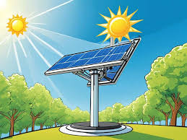
Agenda
INTRODUCTION
LITERATURE SURVEY
RESEARCH GAP
PROBLEM STATEMENT
OBJECTIVES OF THE PROJECT
METHODOLOGY
* block diagram
* flow chart
Results and discussions
Conclusion and Future Scope
references

Slide 4
Abstract
The project involve the designing and implementation of dual -axis solar tracker targeted at achieving the full utilization of solar energy. Conventional solar panels are usually stationary, and this results in low energy production due to the sun's periodic change in position during the day and seasons. A dual-axis tracker achieves efficiency through the change of direction of the angle of the solar panel in the horizontal and vertical planes, thereby ensuring full exposure of the sunlight. The project involves researching the principles of solar energy, selecting the appropriate materials to be used, and constructing a robust frame that accommodates solar panels and tracking mechanisms. LDRs are used as sensors in detecting light intensity, which guides movement as controlled by servo motors with microcontroller in the form of Arduino
Department of ECE, SVIT

Slide 5
Introduction
Solar energy is well known as an unrestricted, endless source, and involves no pollution or greenhouse gases emission. Converting solar energy into electrical energy signifies one of the favorable technologies, providing dirt-free, dependable with negligible environmental impact.
The dual axis trackers collect energy from the sun from the East, West, North, and South angles. They function on two axes –‘primary’ and ‘secondary’.
One axis helps the solar tracker to move from East to West, and the other helps the tracker to move from North to South. Hence, they are known as ‘dual-axis’ solar trackers.
The dual axis trackers can generate up to 40% more electricity than the unmovable solar panel systems that stay at a fixed position.
Besides, due to its movement in all directions, a dual axis tracker is quite flexible.

Slide 6
Literature Survey
Sl.No. | Title of Paper | Methodology | Advantages/Disadvantages/ Future scope
01 | Design And Control Of A Wave-driven Solar Tracker | In This Paper, A Novel Dual-axis Wave Driven Solar Tracker Is Proposed Where The Photovoltaic (PV) Panel Is Adjusted By The Inertia Force And Gravity. | ADVANTAGES: Enhanced Energy Efficiency Sustainability Cost-effectiveness DISADVANTAGES: Complexity Maintenance Challenges Environmental Impact FUTURE SCOPE: Future Research Will Address The System Identification Problem And Enable The Model Parameters To Be Updated Automatically

Slide 7
Literature survey
Sl.No | Title of Paper | Methodology | Advantages/Disadvantages/ Future scope
02 | Optical Selection Of The Control Strategy For Dual -Axis Solar Tracking Systems | The Characterization Of The Tracking System, Then The Constraint Definition Helps To Pre-select The Possible Controllers. Methods That They Imply The Development Of More Rigorous Procedures, Which Rule Out Their Implementation As They Are Systems That Are Built From The Recovery Of Elements (Motors, Mechanisms, Etc.) That Formed Systems For Other Purposes | ADVANTAGES: Increased Energy Capture: Improved Efficiency: Flexibility In Design: Reduced Land Footprint DISADVANTAGES: Complexity And Cost: Mechanical Wear And Tear: Energy Consumption For Tracking Weather Sensitivity FUTURE SCOPE: A New Methodology With A Heuristic Approach Is Presented For The Selection Of The Best Control Strategy For Two Axis Solar Tracking Systems

Slide 8
Literature Survey
Sl.No | Title of Paper | Methodology | Advantages/Disadvantages/ Future scope
03 | On the PV Tracker Performance: Tracking the Sun Versus Tracking the Best Orientation | The Overall Insolation Collection, By Comparing Two Tracking Algorithms, Namely Tracking The Sun (TS) And Tracking The Best Orientation (TBO). It Is Expected To Receive Higher Irradiance With The Drawback Of Requiring A Higher Installation And Maintenance Cost | ADVANTAGES: Maximized Energy Production: Seasonal Adaptability Lower Costs Simpler Design DISADVANTAGES: Higher Costs: Maintenance Requirements FUTURE SCOPE: We Will Aim To Optimize This Parameter Based On A Techno-economic Analysis Considering Local Weather And Economic Conditions Of The Site Of Interest To Minimize The Leveled Cost Of Electricity

Slide 9
Literature Survey
Sl.No. | Title of Paper | Methodology | Advantages/Disadvantages/ Future scope
04 | Increasing The Solar Reliability Factor Of A Dual-axis Solar Tracker Using An Improved Online Built-in Self-test Architecture | Solar Reliability Factor (SRF) By Developing And Implementing An Advanced Online Built-in Selfest (OBIST)Architecture, probabilistic model for defining and addressing stuck-at-faults, enhancing the system’s overall reliability. | ADVANTAGES: Reduced Downtime Predictive Maintenance Improved Performance Data Collection DISADVANTAGES: Initial Implementation Costs Complexity Energy Consumption Dependence On Technology FUTURE SCOPE: Approach To Enhancing Solar Tracker Reliability And Sets The Stage For Future Advancements In The Maintenance

Slide 10
Objectives of the Project
To design a dual solar tracking system that can collect maximum amount of sunlight on the solar panel.
To reduce the need for manual intervention in solar panel positioning
To adapt to changing weather conditions and sunlight intensity, ensuring reliable energy .
To increase the energy generated from a fixed area by maximizing the efficiency of solar panels

Slide 11
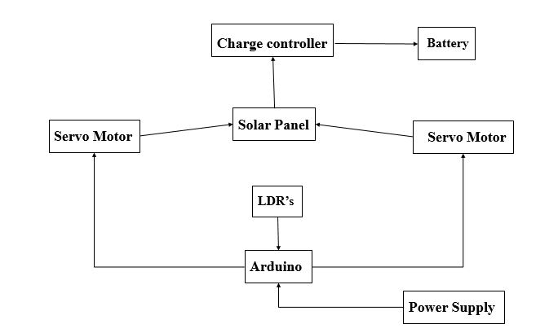
METHODOLOGY
Block Diagram

Slide 12
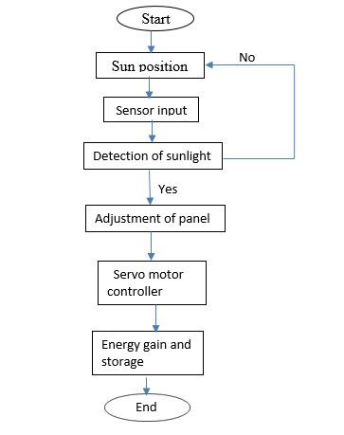
2. Flow Chart/ Algorithm

Slide 13
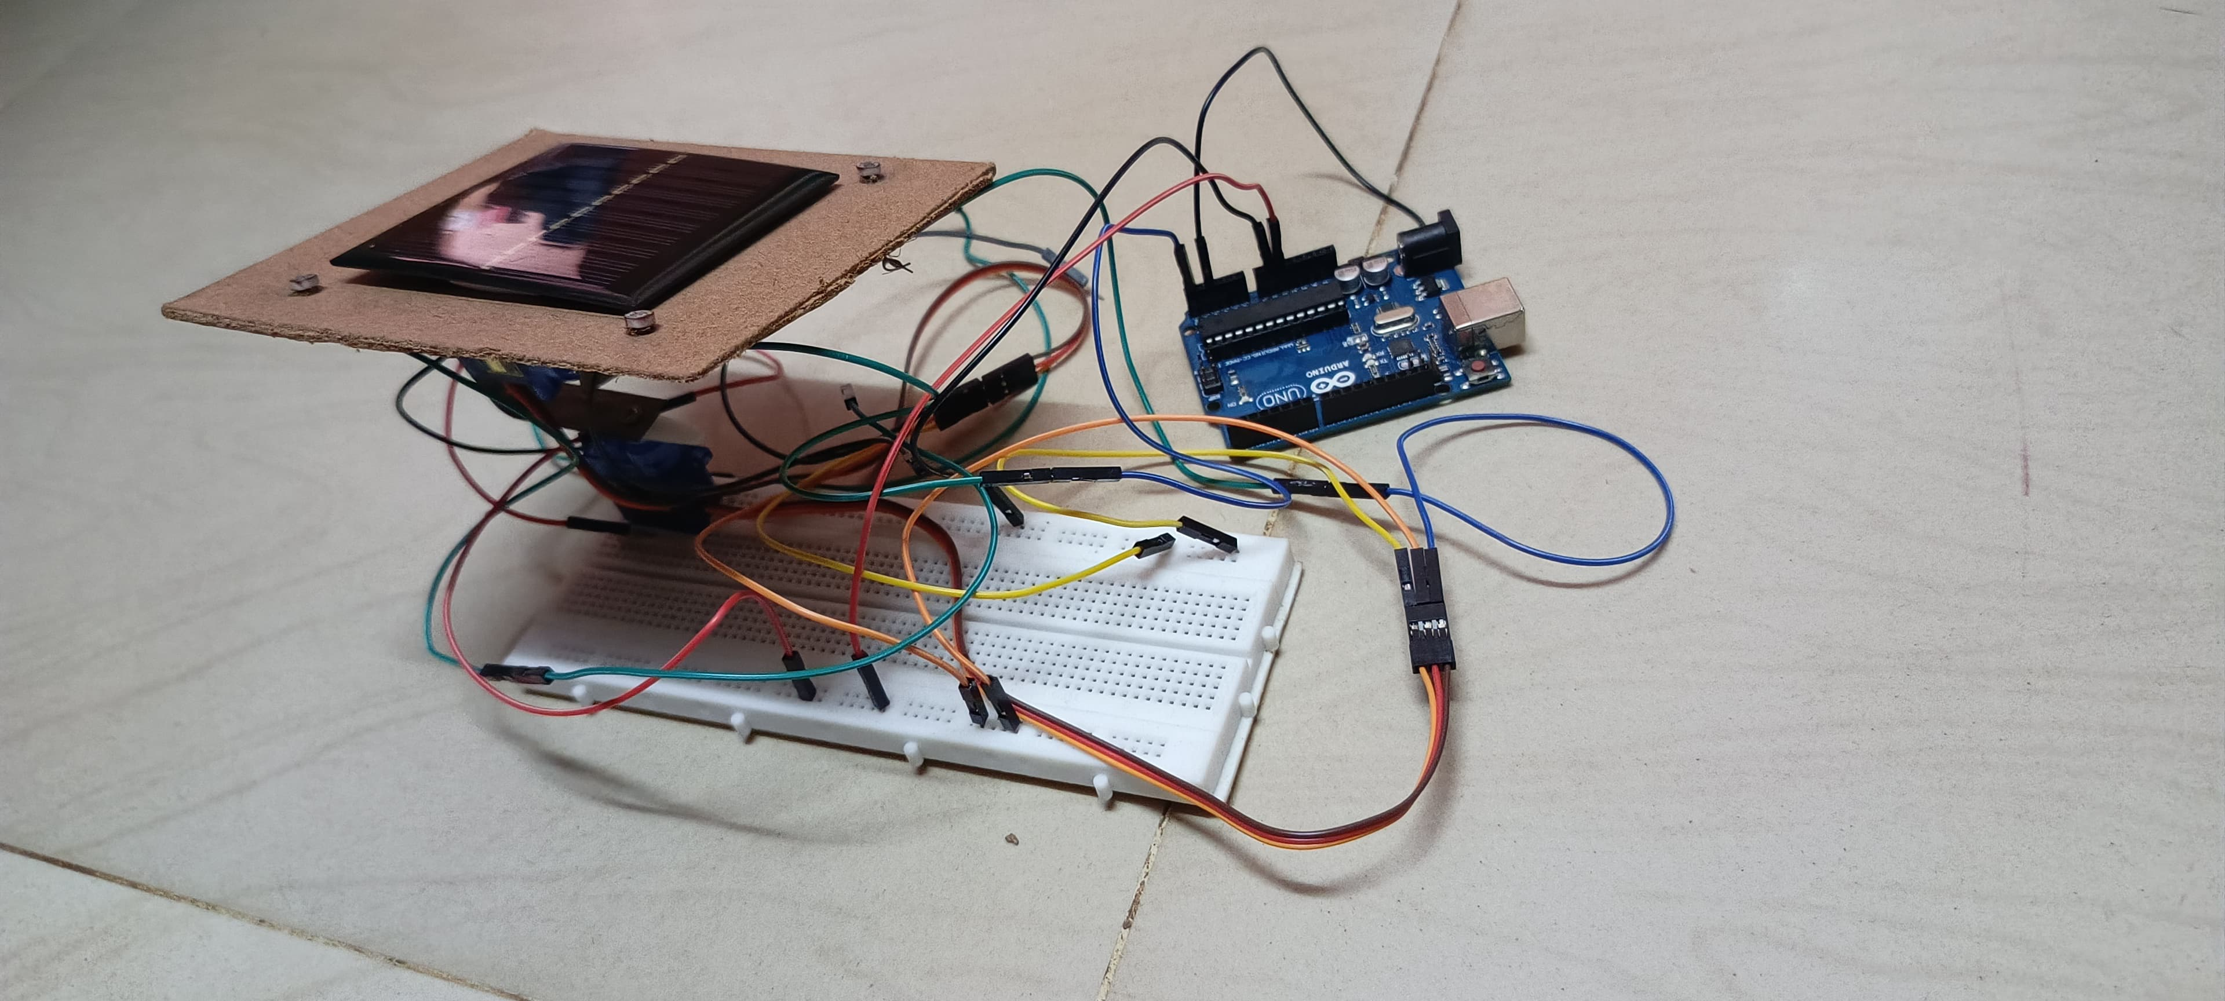
Results and Discussion
The system’s performance will be evaluated based on its ability to track sunlight efficiently, the impact on solar energy collection, and potential improvements. The tracker offers a promising solution for maximizing solar energy generation, with future advancements poised to make the system more efficient, cost-effective, and adaptable to a wide range of applications.
Future improvements in smart sensors, AI integration, and energy harvesting could help address these challenges and make dual-axis solar tracking more cost-effective and reliable for both residential and commercial applications. As the demand for clean and efficient renewable energy sources continues to grow, dual-axis solar trackers hold the potential to play a crucial role in maximizing the benefits of solar energy, contributing to a more sustainable and energy-efficient future.
Figure: Working Model Of A Dual Axis Solar Tracker

Slide 14
Conclusion and Future Scope
The Dual-Axis Solar Tracker system using Arduino, LDR sensors, and servo motors is a highly effective solution for optimizing solar energy collection. By continuously adjusting the position of the solar panel based on sunlight intensity, this system maximizes the amount of solar radiation absorbed, leading to improved energy efficiency. . The photoelectric method was utilized for solar tracking. An extensive analysis of the total daily energy collection of the system was performed Overall, this innovative combination of technologies holds great potential for increasing the output and effectiveness of solar energy systems in various environments.
The future scope of dual-axis solar trackers is vast and full of potential. As technology advances, costs decline, and efficiency improves, dual-axis trackers are expected to play a significant role in the growth of solar energy. They will likely become more accessible for large-scale solar farms and even for residential applications in certain regions, contributing to a greener, more sustainable future.

Slide 15
REFERENCES
1. Lim, Boon-Han, Chern-Sing Lim, Hu Li, Xing-Lan Hu, Kok-Keong Chong, JinLong Zong, Ke Kang, and Woei-Chong Tan. "Industrial design and implementation of a large-scale dual-axis sun tracker with a vertical-axisrotating-platform and multiple-row-elevation structures." Solar Energy 199 (2020): 596-616
2. C. D. Rodríguez-Gallegos, O. Gandhi, S. K. Panda and T. Reindl, "On the PVTracker Performance: Tracking the Sun Versus Tracking the Best Orientation," in IEEE Journal of Photovoltaics, vol. 10, no. 5, pp. 1474-1480, Sept. 2020, doi: 10.1109/JPHOTOV.2020.3006994. keywords: {Sun;Meteorology;Mathematical model;Photovoltaic systems;Sensors;Periodic structures;Bifacial modules;dual axis tracker (2T);horizontal single axis tracker (HSAT);monofacial modules;tilted single axis tracker (TSAT)}.
3. S. L. Jurj and R. Rotar, "Increasing the Solar Reliability Factor of a Dual-Axis Solar Tracker Using an Improved Online Built-In Self-Test Architecture," in IEEE Access, vol. 12, pp. 37715-37730, 2024, doi: 10.1109/ACCESS.2024.3375333. keywords: {Circuit faults;Power system reliability;Computer architecture;Built-in selftest;Integrated circuits;Resistors;Motors;Online services;Tracking;Solar energy;Online built-in self-test;bit-flip mechanism;extended hamming codes;stuck-at faults;solar tracking},
4. M. Saeedi and R. Effatnejad, "A New Design of Dual-Axis Solar Tracking System With LDR Sensors by Using the Wheatstone Bridge Circuit," in IEEE Sensors Journal, vol. 21, no. 13, pp. 14915-14922, 1 July1, 2021, doi: 10.1109/JSEN.2021.3072876. keywords: {Sensors;Bridge circuits;Resistance;Sun;Shafts;Sensor systems;Electrical resistance measurement;Wheatstone bridge;LDR sensors;DAST system;PVpanel;closedloop system},
5. S. I. Palomino-Resendiz, F. A. Ortiz-Martínez, I. V. Paramo-Ortega, J. M. González-Lira and D. A. Flores-Hernández, "Optimal Selection of the Control Strategy for Dual-Axis Solar Tracking Systems," in IEEE Access, vol. 11, pp. 56561-56573, 2023, doi: 10.1109/ACCESS.2023.3283336

Slide 16

THANK YOU

